Slide 1

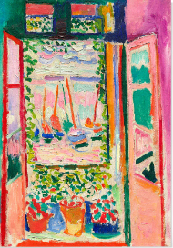
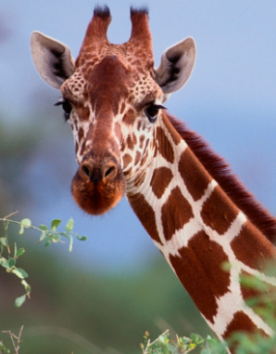
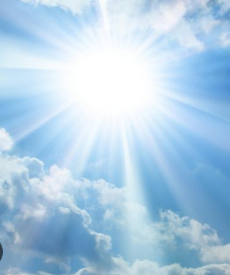
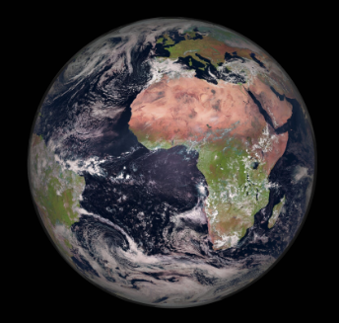
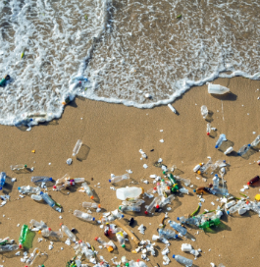
What makes the world beautiful?
What makes art beautiful? | What makes animals beautiful? | What makes the weather beautiful? | What makes the world unique and what is beyond the world? | When is the world not beautiful and how can I change the world?
Colours/patterns
Paintings/sculpture
Clouds/sunshine
Nature/Space
Pollution
Glossary
Sculpture - art that you can touch and see from all sides
Patterns – repeated, stripes, spots, the same again and again
Weather – what is happening in the sky and clouds - sunshine, rain, snow, wind, storm, thunder, lightning
Pollution – anything that makes the earth dirty and unhealthy

