Slide 1

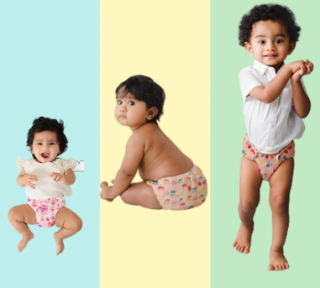
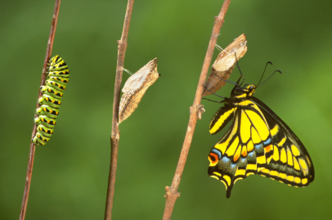
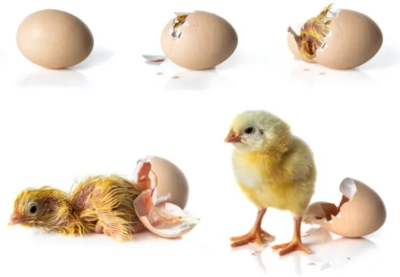
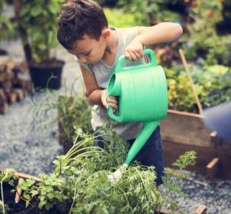
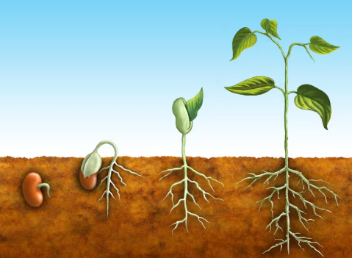
What helps living things grow and change?
How have we changed? | How do we care for living things and how do they change? | What do living things grow from? | How do we care for plants? | How do plants change?
Me
Living things
Chicks
Plants
Change
Glossary
Growing - getting bigger Alive - not dead Develop – to grow and change Life cycle – the journey of a living thing from beginning to end.

